Slide 1

Project Presentation 3 ME 609 – Optimisation Methods in Engineering
Constrained Optimisation Problem
Multivariable Method: Conjugate Direction Method
Unidirectional Search: Bounding Phase & Newton Raphson
Group No : 7
Nirmal S. [234103107]
Rohith Kumar Saragadam [234103109]

Slide 2


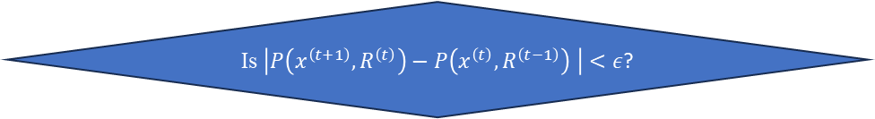



Flowchart
Choose parameters of algorithm and termination
$ε, x^{(0)}, Ω, R^{\left(0\right)}, c$, set $t=0$
Form penalty function
$$P=f\left(x^{\left(t\right)}\right)+Ω\left(R^{\left(t\right)}, g\left(x^{\left(t\right)}\right), h\left(x^{\left(t\right)}\right)\right)$$
Use “Conjugate Direction Method” for obtaining the minimum point of the multidimensional equation
Starting from $x^{\left(t\right)}$, find $x^{\left(t+1\right)}$ such that $P\left(x^{\left(t\right)}, R^{\left(t\right)}\right)$ is minimum for fixed value of R.
Choose $R^{\left(t+1\right)}=cR^{\left(t\right)}$
Set $t=t+1$
Is $\left|P\left(x^{\left(t+1\right)}, R^{\left(t\right)}\right)−P\left(x^{\left(t\right)}, R^{\left(t−1\right)}\right) \right|<ε$?
Use of “Bounding Phase and Newton Raphson Method” to obtain the minimum point in ‘Unidirectional Search’ in Conjugate Direction Method.
Set $x^{\left(T\right)}=x^{\left(t+1\right)}$
Terminate

Slide 3
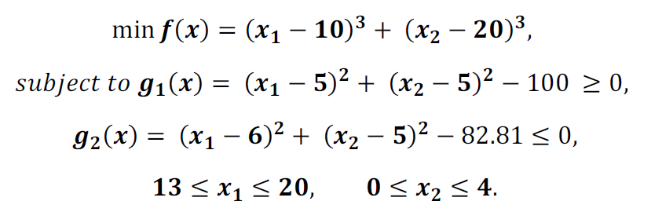
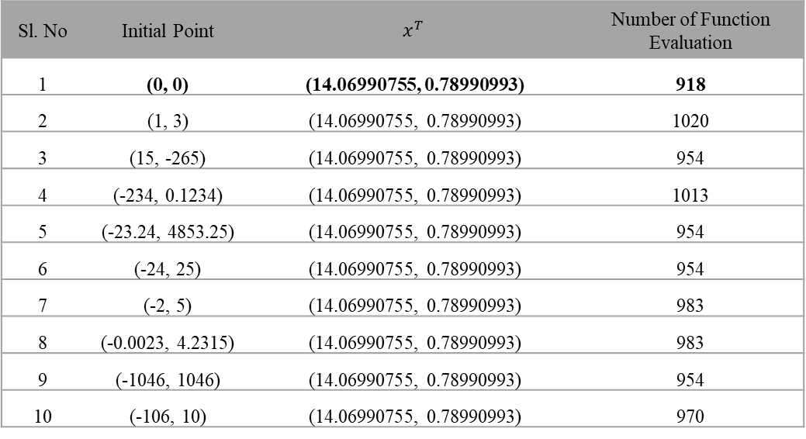
Problem 1
Sl. No | Initial Point | $$x^{T}$$ | Number of Function Evaluation
1 | (0, 0) | (14.06990755, 0.78990993) | 918
2 | (1, 3) | (14.06990755, 0.78990993) | 1020
3 | (15, -265) | (14.06990755, 0.78990993) | 954
4 | (-234, 0.1234) | (14.06990755, 0.78990993) | 1013
5 | (-23.24, 4853.25) | (14.06990755, 0.78990993) | 954
6 | (-24, 25) | (14.06990755, 0.78990993) | 954
7 | (-2, 5) | (14.06990755, 0.78990993) | 983
8 | (-0.0023, 4.2315) | (14.06990755, 0.78990993) | 983
9 | (-1046, 1046) | (14.06990755, 0.78990993) | 954
10 | (-106, 10) | (14.06990755, 0.78990993) | 970
Observation:
It takes around 1000 function evaluations for any initial point.

Slide 4
Problem 1
Sequence(t) | R(t) | x(t) | P(x(t), R(t))
1 | 0.1 | (0.0, 0.0) | -8750
 |  | (13.1236, 0.0) | -7961.41
 |  | … | …
 |  | (13.1236, 0.0) | -7961.41
2 | 1 | (13.1236, 0.0) | -7888.39
 |  | (13.5949, 0.0) | -7952.27
 |  | … | …
 |  | (13.5949, 0.0) | -7952.27
3 | 10 | (13.5949, 0.0) | -7940.82
 |  | (13.6316, 0.0) | -7947.79
 |  | … | …
 |  | (13.6316, 0.0) | -7947.79
4 | 100 | (13.6316, 0.0) | -7908.95
 |  | (13.6349, 0.0) | -7909.54
 |  | … | …
 |  | (13.6349, 0.0) | -7909.54
5 | 1000 | (13.6349, 0.0) | -7527.67
 |  | (13.6353, 0.0) | -7527.73
 |  | … | …
 |  | (13.6353, 0.0) | -7527.73
6 | 10000 | (13.6353, 0.0) | -3709.67
 |  | (13.6353, 0.0) | -3709.68
 |  | … | …
 |  | (13.8762, 0.4074) | -6313.92
7 | 100000 | (13.8762, 0.4074) | 4025.336
 |  | (13.8712, 0.4074) | 2591.357
 |  | … | …
 |  | (13.0, -1.1524) | 1624812
8 | 1000000 | (13.0, -1.1524) | 16333059
 |  | (13.0, -1.1524) | 16333059
 |  | … | …
 |  | (14.0637, 0.7787) | -5072.91
 |  | (14.0699, 0.7899) | -5415.28
Observation:
At the end of 8th sequence, the point converges near optimum value.

Slide 5
Problem 1
Observation:
The values of Penalty function changes with each new sequence and then reduces over iterations in the sequence.

Slide 6
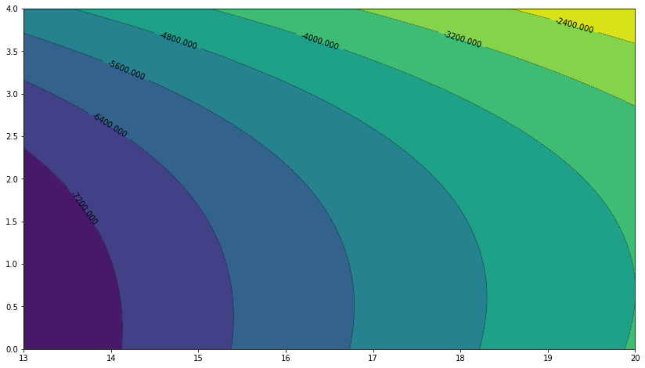
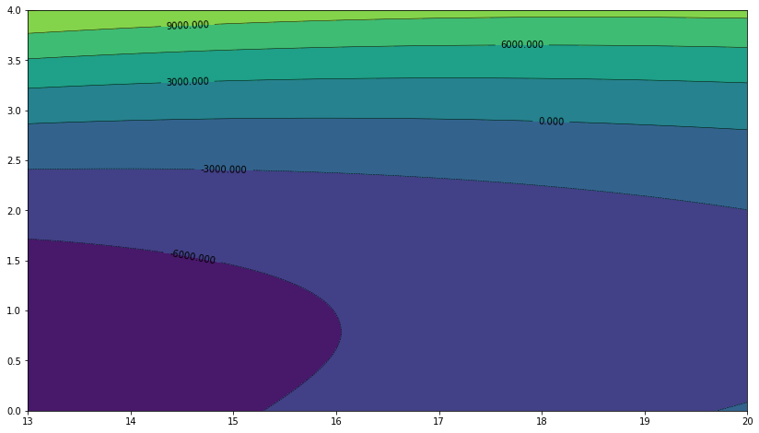
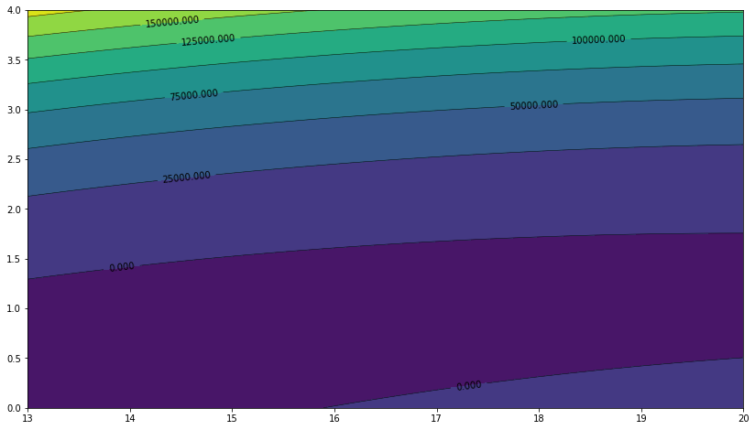
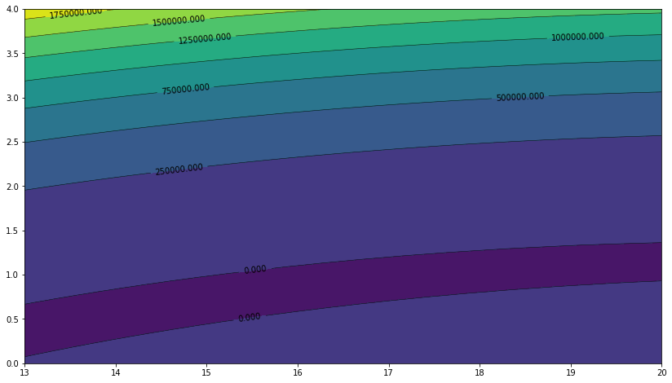
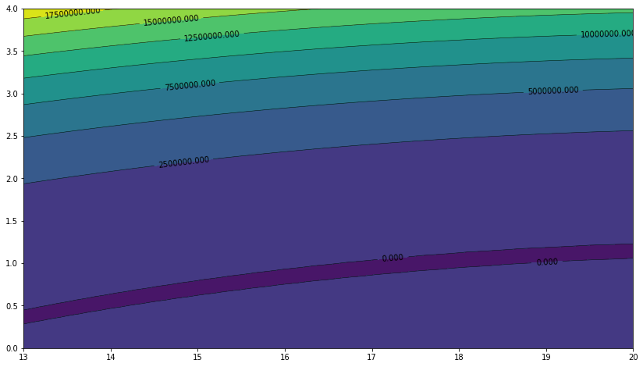
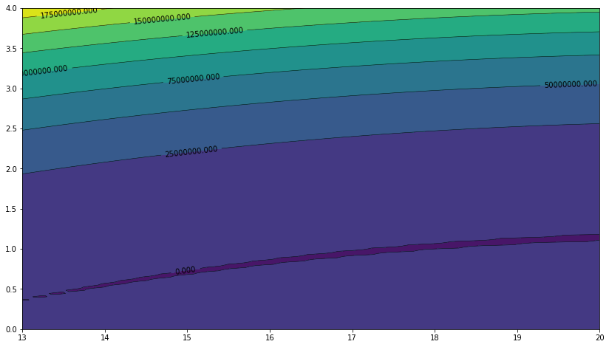
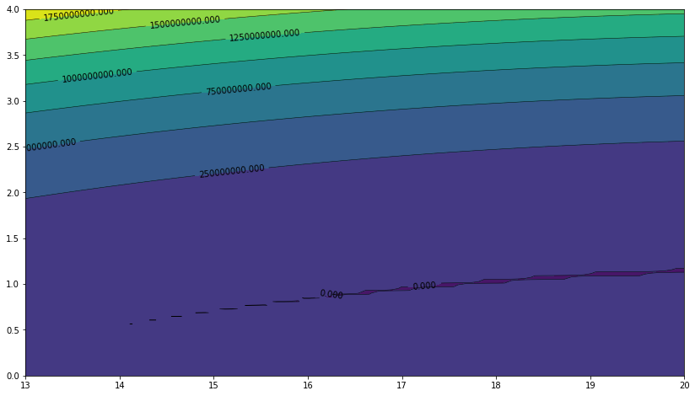
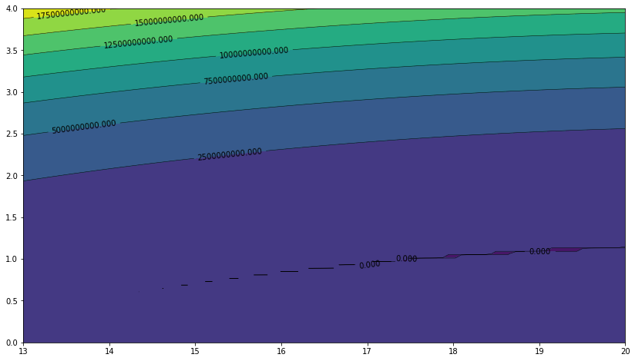








Problem 1 Contours
$$R=0.1$$
$$R=1$$
$$R=10$$
$$R={10}^{2}$$
$$R={10}^{3}$$
$$R={10}^{4}$$
$$R={10}^{5}$$
$$R={10}^{6}$$

Slide 7
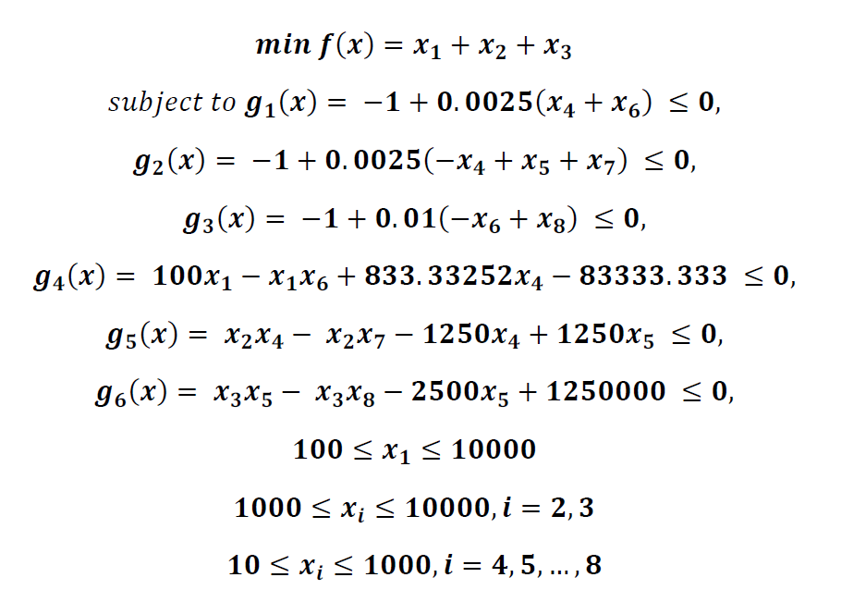
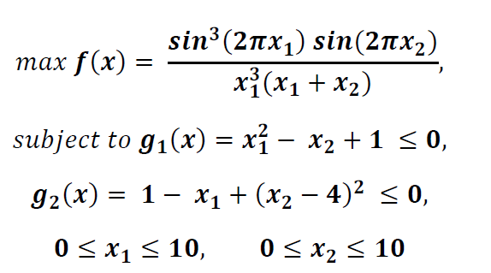
Problem 2, 3
Result:
Unable to solve the constrained optimization problems due to the values running to large number leading to nan error.

Slide 8
Thank you

